Slide 1


FIRST STEP INTO CASE STUDIES
Presented By:
Data Mavericks

Slide 2
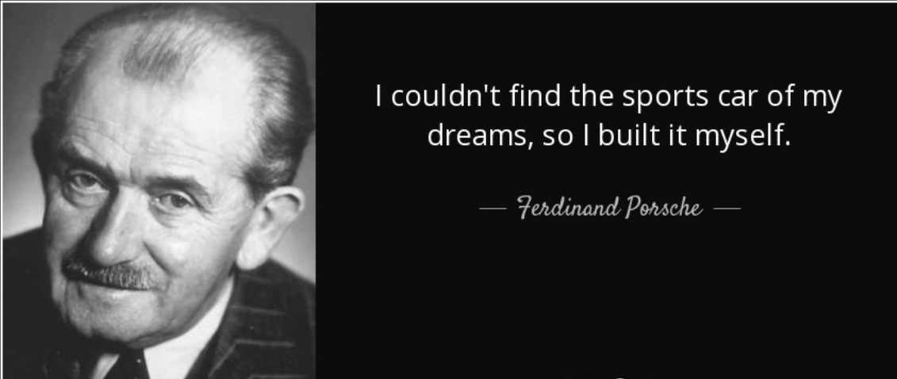

Slide 3

AUTOMOTIVE MARKET ANALYSIS: SALES TRENDS AND DATA INSIGHTS
SEGMENT : RETAIL

Slide 4

TOPICS COVERED
Introduction of the topic
Typical Process Steps in Data Science Project
Meet the Team
Roles & Responsibilities
User Story
Data Cleaning & Preparation
Data Visualization & Analytics
Conclusion

Slide 5
TYPICAL PROCESS STEPS IN DATA SCIENCE

Slide 6




Aparna Dash (Varsha)
Sandhya Tripathi
Disha Gayathri Umashankar

Slide 7
ROLES AND RESPONSIBILITIES
Data Sourcing and Acquisition: Disha Gayathri Umashankar
Data Preparation and Presentation: Sandhya Tripathi
Data Visualization and Analysis: Aparna Dash

Slide 8



Firm Name: Auto Works
Customer: Mr. Adam Müller
Profile: Country Sales Manager
Vehicle Category: Light Vehicle
Country : USA ( 42 States)
Year –(2022-2023)
Vehicle Details ( Make, Model Year, Colour)
Transaction Information ( Date of Manuf, Date of Sale)
Market Trends
Condition and Mileage
Scope
Challenges
Key Parameters
Understanding Consumer Preferences
Identifying Market Demand
Optimizing Pricing Strategy
Objective
As Country Sales Manager of Auto Works firm, Mr. Adam wants to gain business insights into the sales performance and market trends of Cars in USA, so that he can make informed decisions to identify consumer preferences, market demand and pricing strategy.
Mr.Adam Müller

Slide 9


Slide 10
Data Set Comparison before and After Data Cleaning
Before Cleaning the data | After Cleaning the data
558837 Records and 16 Columns | 558599 Records and 18 Column
Year, Make, Model, Trim, Body, Transmission, State, Condition, Odometer, Colour, Interior, Seller , MMR, Selling Price, Sale Date | Added Sale Year and Sale Month in the Table
Removed Null Values, White Spaces, Rearranges Column | After removed records reduced to 558599
Handling of Missing Values | All Missing values were removed
Date format were not standardized | Standardized Date Format
Check and correction of spellings for example US State names | Spell Check completed
Data Source : www.kaggle.com
Data Cleaning : https://www.tableau.com/

Slide 11
FINAL PARAMETERS CAPTURED AFTER CLAENING OF DATA
Parameter | Details
1. Year | Year of Manufacturing
2. Make | Make of the vehicle (e.g. BMW, Audi, Porche)
3. Model | Model of the Vehicle
4.Trim Level | To identify a vehicle's level of equipment or special features( e.g. Swift Dezire VDI)
5. Body | Sedan, Hatchback, Coupe
6. Transmission | Automatic/Manual
7. USA States | 42 States have been considered
8. Condition Rating | 1-49 depending on the condition of the vehicle
9. Odometer | Odometer Reading to measure the distance travelled by a Car
10. Exterior Color | Body of the Car
11. Interior Color | Inner look of the Car
12. Seller | Name and Address
13. MMR | ( Manheim Market Report) Market Value as indicated by MMR
14. Selling Price | The Company Offer Price on which vehicle was sold
15. Sale Date | Date of Vehicle sold
16.Sale Year | Year on which vehicle was sold
17. Sale Month | Month on which vehicle was sold

Slide 12

Data Visualization & Analytics

Slide 13
SAS Dashboard
Geo Map
Sales Over the Years
Sellers & Style
High/Low End Cars
Colour Preferences
Pricing Distribution
Pricing Strategy

Slide 14
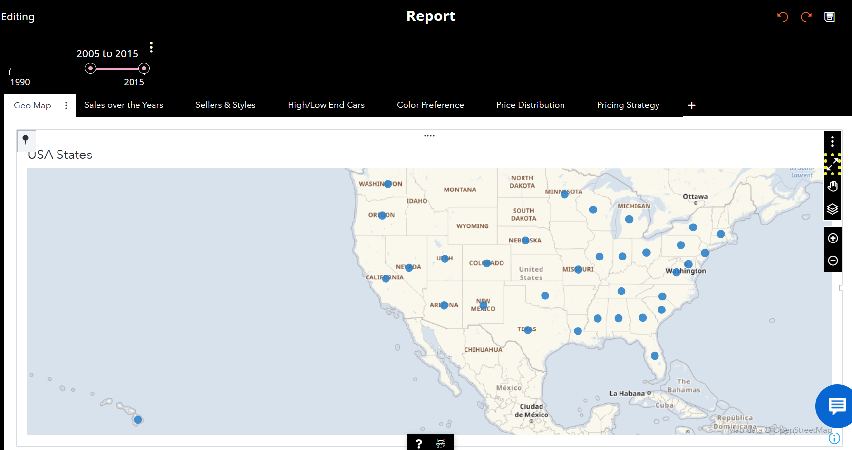
Geo Map representing Sales Regions of USA

Slide 15
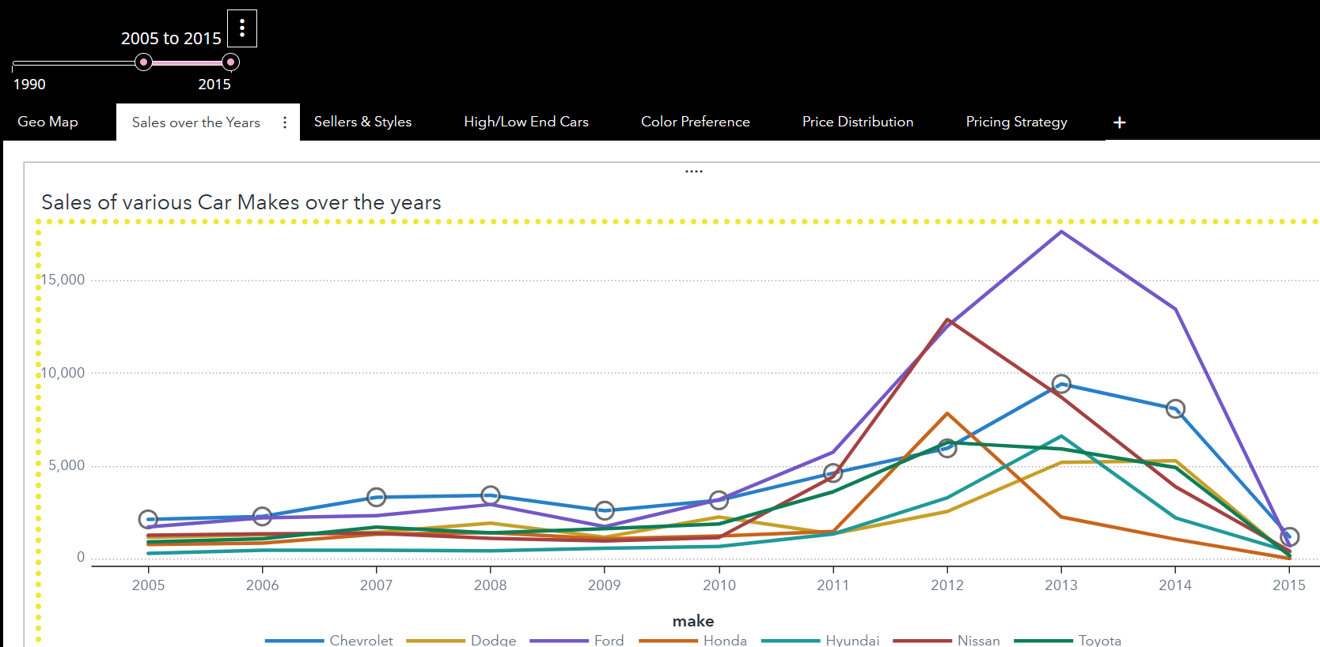
YoY sales of Various Cars ( for e.g. 2005 to 2015)

Slide 16
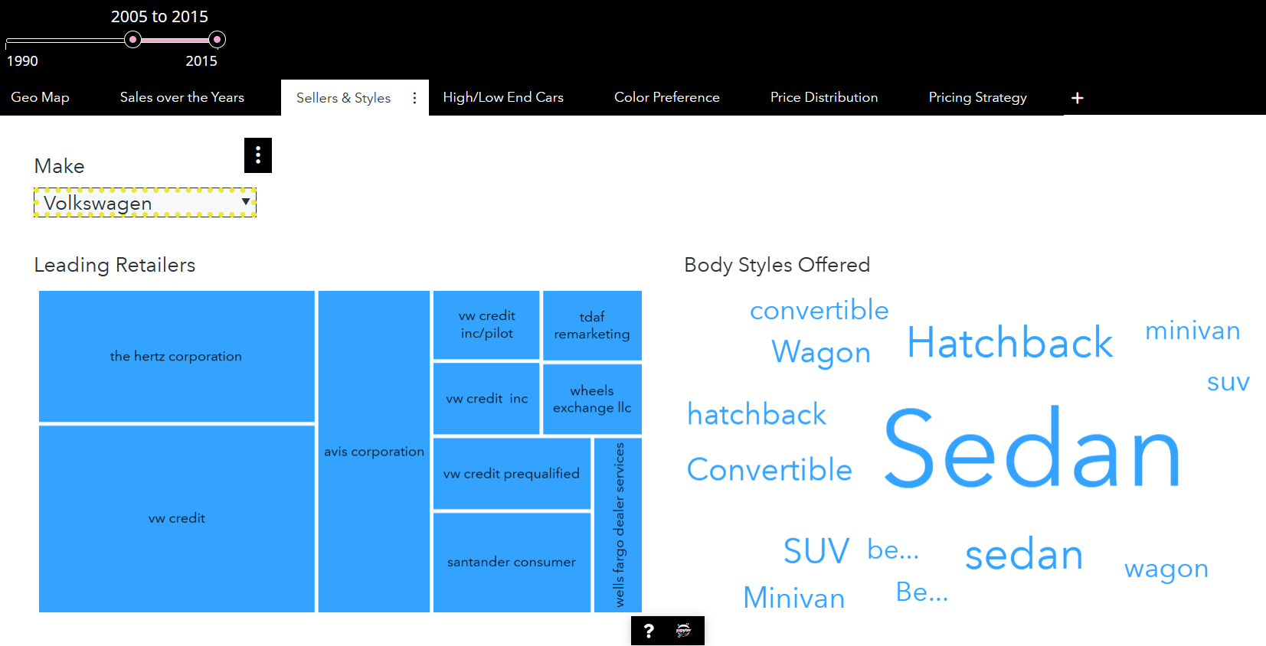
YoY seller & Style of Various Cars ( for e.g. 2005 to 2015)

Slide 17
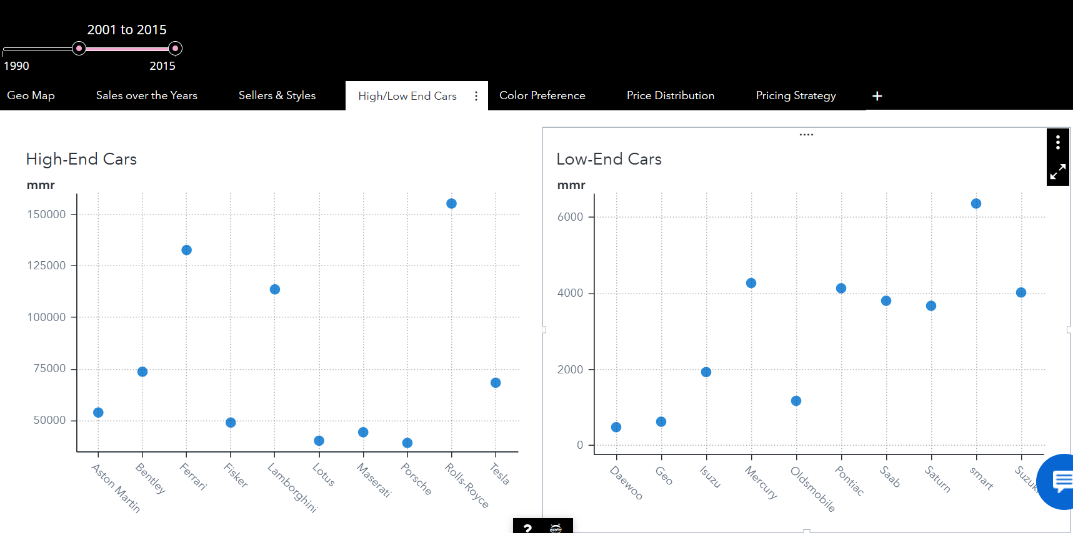
MMR : High End Cars & Low End Cars

Slide 18
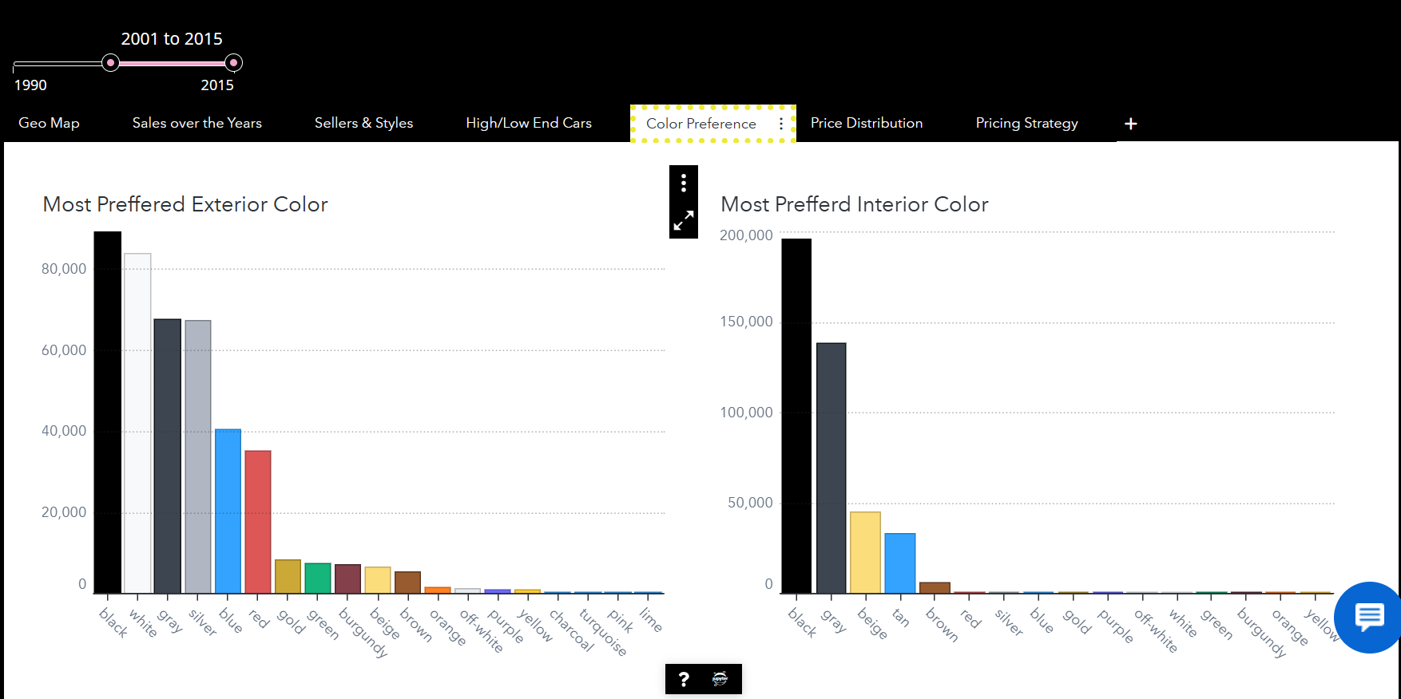
Colour Preference by Consumers

Slide 19
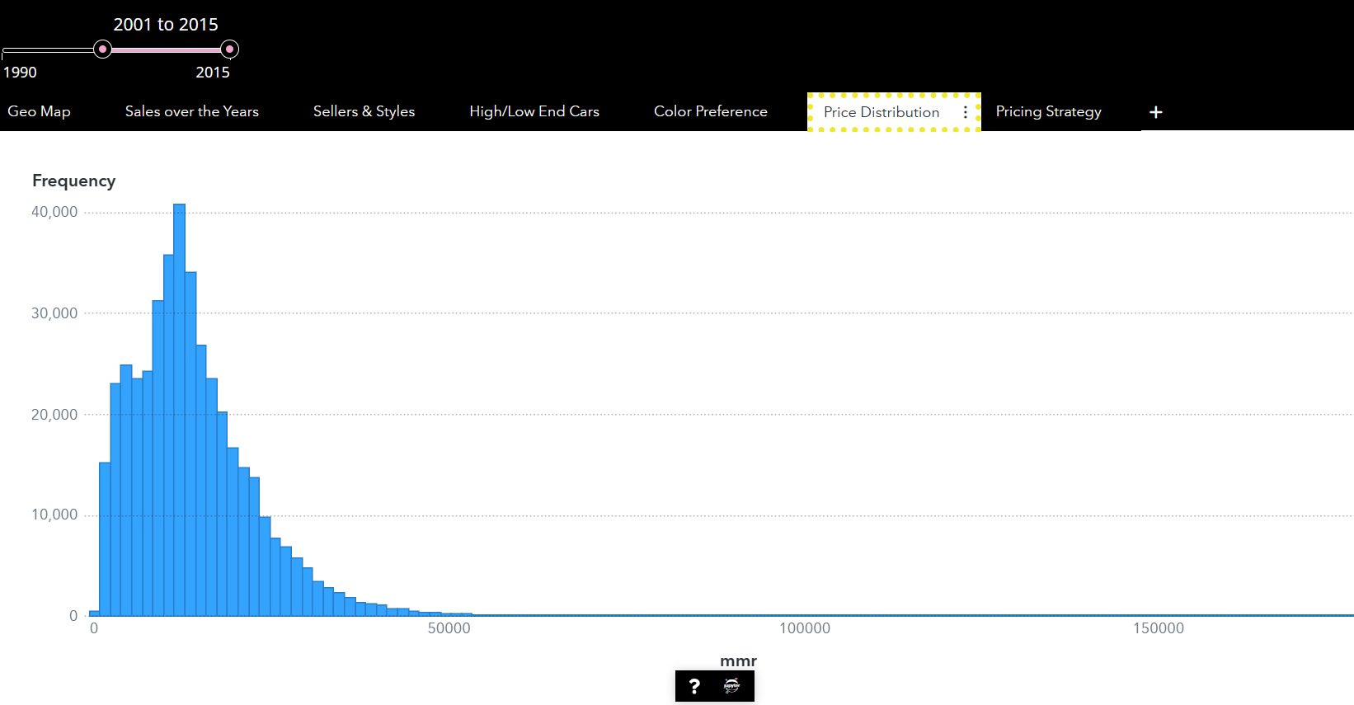
Price Distribution of the Various Models

Slide 20
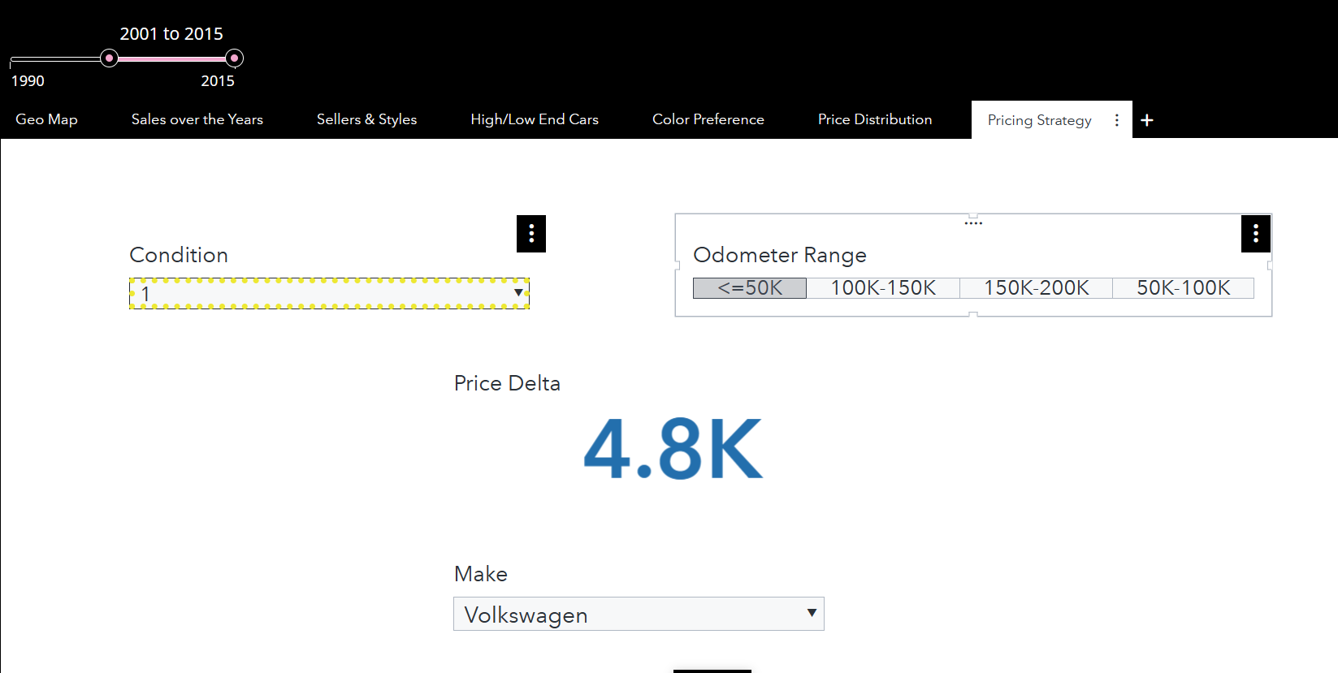
Pricing Strategy By the CSM

Slide 21
CONCLUSION

Slide 22
Vote of Thanks
Professors
Classmates
SAS
Google
Kaggle
Tableau
Canva
ChatGpt
Vinseeker
Toonme
Porsche

Slide 23


